Slide 1
Maintenance Task Group Closing Plenary
San Francisco
July 21, 2011
Paul Congdon

Slide 2
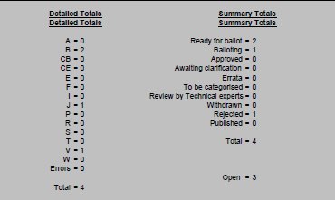
Maintenance Report
Code | Description | Code | Description | Code | Description
A | Approved in Ballot | F | Failed in ballot | S | Published in Errata Sheet
B | Awaiting Ballot | I | Incomplete | T | Awaiting Technical Experts
CB | Awaiting change text -Ballot | J | Rejected | V | Balloting
CE | Awaiting change text - Errata | P | Published | W | Withdrawn
E | Errata – ballot not required | R | Request Received

Slide 3
Maintenance Summary
Req# | Status | Standard | Clause | Submitted | Subject
0003 | Balloting | 802.1Q-2011 | 20.2.2, 20.28.2, 12.14 | 26-Mar-11 | Inconsistent VID for Loopback Reply (LBR) frames
0004 Closed | Rejected | 802.1Q-2005 | 13.37.1 | 07-Apr-11 | No path cost for 40Gbps links
0005 | Ready for Ballot | 802.1Q-2011 | D4 and LLDP-EXT-DOT1-V2-MIB.mib | 17-Jun-11 | Missing enable for Link Aggregation TLV
0006 | Ready for Ballot | 802.1AS-2011 | various | 23-Jun-11 | Corrigendum items agreed to in AVB TG

Slide 4
Maintenance Request Form
Similar to a ballot comment
Text document linked off maintenance page:
http://ieee802.org/1/maint.html
Submitter emails to:
stds-802-1-maint-req@listserv.ieee.org
Archive of submissions is at:
http://www.ieee802.org/1/private/email_mq/mail1.html
Subscribe by sending to:
stds-802-1-maint-req-subscribe-request@listserv.ieee.org
You do not have to subscribe to file a maintenance request

