Slide 1
Instructions for the WG Chair
The IEEE SA strongly recommends that at each WG meeting the chair or a designee:
  Show slides 1 through 4 of this presentation
  Advise the WG attendees that:
    IEEE’s patent policy is described in Clause 6 of the IEEE SA Standards Board Bylaws;
    Early identification of patent claims which may be essential for the use of standards under development is strongly encouraged;
    There may be Essential Patent Claims of which IEEE is not aware. Additionally, neither IEEE, the WG, nor the WG Chair can ensure the accuracy or completeness of any assurance or whether any such assurance is, in fact, of a Patent Claim that is essential for the use of the standard under development.
  Instruct the WG Secretary to record in the minutes of the relevant WG meeting:
    That the foregoing information was provided and that slides 1 through 4 (and this slide 0, if applicable) were shown;
    That the chair or designee provided an opportunity for participants to identify patent claim(s)/patent application claim(s) and/or the holder of patent claim(s)/patent application claim(s) of which the participant is personally aware and that may be essential for the use of that standard
    Any responses that were given, specifically the patent claim(s)/patent application claim(s) and/or the holder of the patent claim(s)/patent application claim(s) that were identified (if any) and by whom.
  The WG Chair shall ensure that a request is made to any identified holders of potential essential patent claim(s) to complete and submit a Letter of Assurance.
  It is recommended that the WG Chair review the guidance in IEEE SA Standards Board Operations Manual 6.3.5 and in FAQs 14 and 15 on inclusion of potential Essential Patent Claims by incorporation or by reference.
Note: WG includes Working Groups, Task Groups, and other standards-developing committees with a PAR approved by the IEEE SA Standards Board.
08 June 2021 – Slide 0 – optional to be shown

Slide 2
Participants have a duty to inform the ieee
  Participants shall inform the IEEE (or cause the IEEE to be informed) of the identity of each holder of any potential Essential Patent Claims of which they are personally aware if the claims are owned or controlled by the participant or the entity the participant is from, employed by, or otherwise represents
  Participants should inform the IEEE (or cause the IEEE to be informed) of the identity of any other holders of potential Essential Patent Claims
  Early identification of holders of potential Essential Patent Claims is encouraged
08 June 2021 – Slide 1

Slide 3
Ways to inform ieee
Cause an LOA to be submitted to the IEEE SA (patcom@ieee.org); or
Provide the chair of this group with the identity of the holder(s) of any and all such claims as soon as possible; or
Speak up now and respond to this Call for Potentially Essential Patents
If anyone in this meeting is personally aware of the holder of any patent claims that are potentially essential to implementation of the proposed standard(s) under consideration by this group and that are not already the subject of an Accepted Letter of Assurance, please respond at this time by providing relevant information to the WG Chair
08 June 2021 – Slide 2

Slide 4
Other Guidelines for IEEE Working Group Meetings
All IEEE SA standards meetings shall be conducted in compliance with all applicable laws, including antitrust and competition laws.
  Don’t discuss the interpretation, validity, or essentiality of patents/patent claims.
  Don’t discuss specific license rates, terms, or conditions.
    Relative costs of different technical approaches that include relative costs of patent licensing terms may be discussed in standards development meetings.
      Technical considerations remain the primary focus.
  Don’t discuss or engage in the fixing of product prices, allocation of customers, or division of sales markets.
  Don’t discuss the status or substance of ongoing or threatened litigation.
  Don’t be silent if inappropriate topics are discussed. Formally object to the discussion immediately.
---------------------------------------------------------------
For more details, see IEEE SA Standards Board Operations Manual, clause 5.3.10 and
Antitrust and Competition Policy: What You Need to Know at http://standards.ieee.org/develop/policies/antitrust.pdf
08 June 2021 – Slide 3

Slide 5
Patent-related information
The patent policy and the procedures used to execute that policy are documented in the:
      IEEE SA Standards Board Bylaws (http://standards.ieee.org/develop/policies/bylaws/sect6-7.html#6)
      IEEE SA Standards Board Operations Manual (http://standards.ieee.org/develop/policies/opman/sect6.html#6.3)
  Material about the patent policy is available at http://standards.ieee.org/about/sasb/patcom/materials.html
If you have questions, contact the IEEE SA Standards Board Patent Committee Administrator at patcom@ieee.org
08 June 2021 – Slide 4

Slide 6
Instructions for Chairs of standards development activities
At the beginning of each standards development meeting the chair or a designee is to:
    Show the following slides (or provide them beforehand)
    Advise the standards development group participants that:
    IEEE SA’s copyright policy is described in Clause 7 of the IEEE SA Standards Board Bylaws and Clause 6.1 of the IEEE SA Standards Board Operations Manual;
    Any material submitted during standards development, whether verbal, recorded, or in written form, is a Contribution and shall comply with the IEEE SA Copyright Policy;
    Instruct the Secretary to record in the minutes of the relevant meeting:
    That the foregoing information was provided and that the copyright slides were shown (or provided beforehand).
2

Slide 7
IEEE SA Copyright Policy
By participating in this activity, you agree to comply with the IEEE Code of Ethics, all applicable laws, and all IEEE policies and procedures including, but not limited to, the IEEE SA Copyright Policy.
    Previously Published material (copyright assertion indicated) shall not be presented/submitted to the Working Group nor incorporated into a Working Group draft unless permission is granted.
    Prior to presentation or submission, you shall notify the Working Group Chair of previously Published material and should assist the Chair in obtaining copyright permission acceptable to IEEE SA.
    For material that is not previously Published, IEEE is automatically granted a license to use any material that is presented or submitted.
3

Slide 8
IEEE SA Copyright Policy
    The IEEE SA Copyright Policy is described in the IEEE SA Standards Board Bylaws and IEEE SA Standards Board Operations Manual
      IEEE SA Copyright Policy, see
      Clause 7 of the IEEE SA Standards Board Bylaws
      https://standards.ieee.org/about/policies/bylaws/sect6-7.html#7
      Clause 6.1 of the IEEE SA Standards Board Operations Manual
      https://standards.ieee.org/about/policies/opman/sect6.html
    IEEE SA Copyright Permission
      https://standards.ieee.org/content/dam/ieee-standards/standards/web/documents/other/permissionltrs.zip
    IEEE SA Copyright FAQs
      https://standards.ieee.org/faqs/copyrights/
    IEEE SA Best Practices for IEEE Standards Development
      http://standards.ieee.org/develop/policies/best_practices_for_ieee_standards_development_051215.pdf
    Distribution of Draft Standards (see 6.1.3 of the SASB Operations Manual)
      https://standards.ieee.org/about/policies/opman/sect6.html
4

Slide 9
Participant behavior in IEEE-SA activities is guided by the IEEE Codes of Ethics & Conduct
  All participants in IEEE-SA activities are expected to adhere to the core principles underlying the:
    IEEE Code of Ethics
    IEEE Code of Conduct
  The core principles of the IEEE Codes of Ethics & Conduct are to:
    Uphold the highest standards of integrity, responsible behavior, and ethical and professional conduct
    Treat people fairly and with respect, to not engage in harassment, discrimination, or retaliation, and to protect people's privacy.
    Avoid injuring others, their property, reputation, or employment by false or malicious action
  The most recent versions of these Codes are available at http://www.ieee.org/about/corporate/governance

Slide 10
Participants in the IEEE-SA “individual process” shall act independently of others, including employers
  The IEEE-SA Standards Board Bylaws require that “participants in the IEEE standards development individual process shall act based on their qualifications and experience”
  This means participants:
    Shall act & vote based on their personal & independent opinions derived from their expertise, knowledge, and qualifications
    Shall not act or vote based on any obligation to or any direction from any other person or organization, including an employer or client, regardless of any external commitments, agreements, contracts, or orders
    Shall not direct the actions or votes of other participants or retaliate against other participants for fulfilling their responsibility to act & vote based on their personal & independently developed opinions
  By participating in standards activities using the “individual process”, you are deemed to accept these requirements; if you are unable to satisfy these requirements then you shall immediately cease any participation

Slide 11
IEEE SA standards activities shall allow the fair & equitable consideration of all viewpoints
The IEEE SA Standards Board Bylaws (clause 5.2.1.3) specifies that “the standards development process shall not be dominated by any single interest category, individual, or organization”
    This means no participant may exercise “authority, leadership, or influence by reason of superior leverage, strength, or representation to the exclusion of fair and equitable consideration of other viewpoints” or “to hinder the progress of the standards development activity”
This rule applies equally to those participating in a standards development project and to that project’s leadership group
Any person who reasonably suspects that dominance is occurring in a standards development project is encouraged to bring the issue to the attention of the Standards Committee or the project’s IEEE SA Program Manager

Slide 12
Participants in attendance at IEEE Standards development activity meetings shall follow appropriate meeting decorum, and the SA meeting rules, including but not limited to:
Recording (e.g., via audio, video, photography, artificial intelligence (AI) application or other software) of the proceedings by any participant or observer other than Officers of this IEEE standards development group, in part or in whole, via any means, is NOT permitted. (See IEEE Standards Board Operations Manual subclause 5.3.3.2 Recordings of the proceedings of standards development meetings)
Participants intending to report publicly on this meeting (e.g., news outlets, social media, or online forums) shall inform the Chair of their attendance and the Chair shall announce their presence and their intent to report publicly.(See IEEE Standards Board Operations Manual Subclause 5.3.3.3 Press attendance)
Participants shall comply with IEEE SA Standards Board Operations Manual 5.1.4 Standards promotion and social media communication

Slide 13
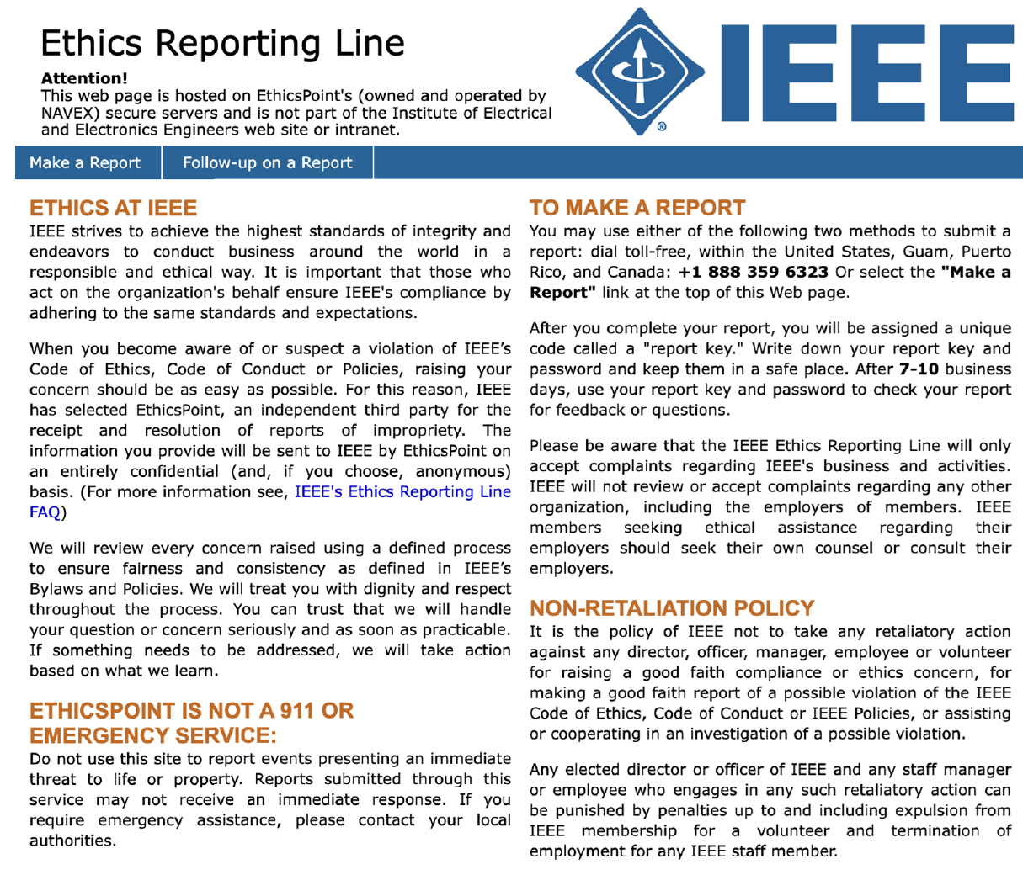
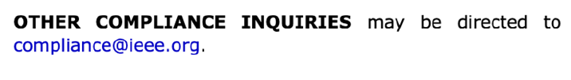
IEEE ETHICS REPORTING LINE
Reports alleging violations of IEEE's Code of Conduct, Code of Ethics, or other policies and rules, can be reported in two ways:
• Phone: +1 888-359-6323
• Web: www.ieee-ethics-reporting.org
Under IEEE Bylaw I-110 and IEEE Policy 7.10, any individual may report an allegation of misconduct against a member, or a non-member engaged in an IEEE activity. Reports may be filed anonymously.
References
Code of Ethics:
https://www.ieee.org/about/corporate/governance/p7-8.html
Code of Conduct:
https://www.ieee.org/about/corporate/governance/code-of-conduct.html

